Slide 1
Transportation function

Slide 2
Multistage transportation problem
Let us consider a multi-stage transportation problem where the goods are to be transported from factories to intermediate warehouses and then the retailers.
Let us model these two stages explicitly.
Stage 1: Factories → Warehouses
Stage 2: Warehouse → Retailers

Slide 3
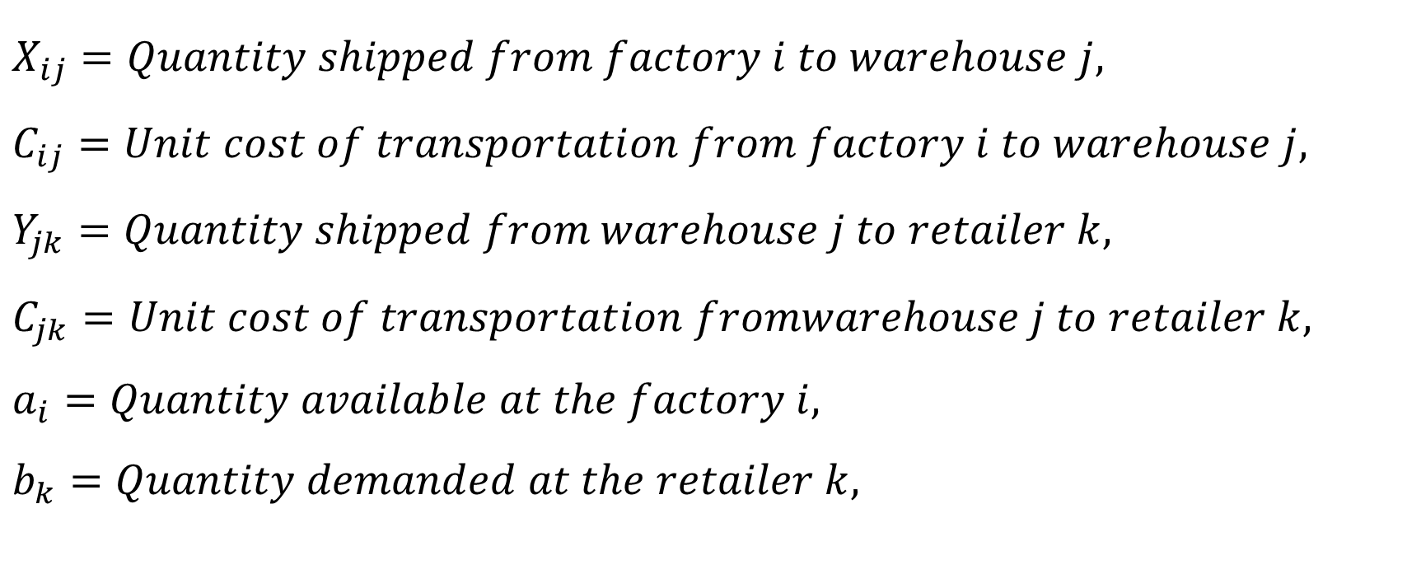
Multistage transportation problem
$$X_{ij}=Quantity shipped from factory i to warehouse j,$$
$$C_{ij}=Unit cost of transportation from factory i to warehouse j,$$
$$Y_{jk}=Quantity shipped from warehouse j to retailer k,$$
$$C_{jk}=Unit cost of transportation fromwarehouse j to retailer k,$$
$$a_{i}=Quantity available at the factory i,$$
$$b_{k}=Quantity demanded at the retailer k,$$

Slide 4

Multistage transportation problem
$$Min Z=\sum_{i}{\sum_{j}{C_{ij}X_{ij}}}+\sum_{j}{\sum_{k}{C_{jk}Y_{jk}}}$$
Subject to:
$$\sum_{j}{X_{ij}}≤a_{i}, ∀i$$
$$\sum_{j}{Y_{jk}}≥b_{k}, ∀k$$
$$\sum_{i}{X_{ij}}≥\sum_{k}{Y_{jk}}, ∀j$$
$$X_{ij}, Y_{jk}≥0$$

Slide 5
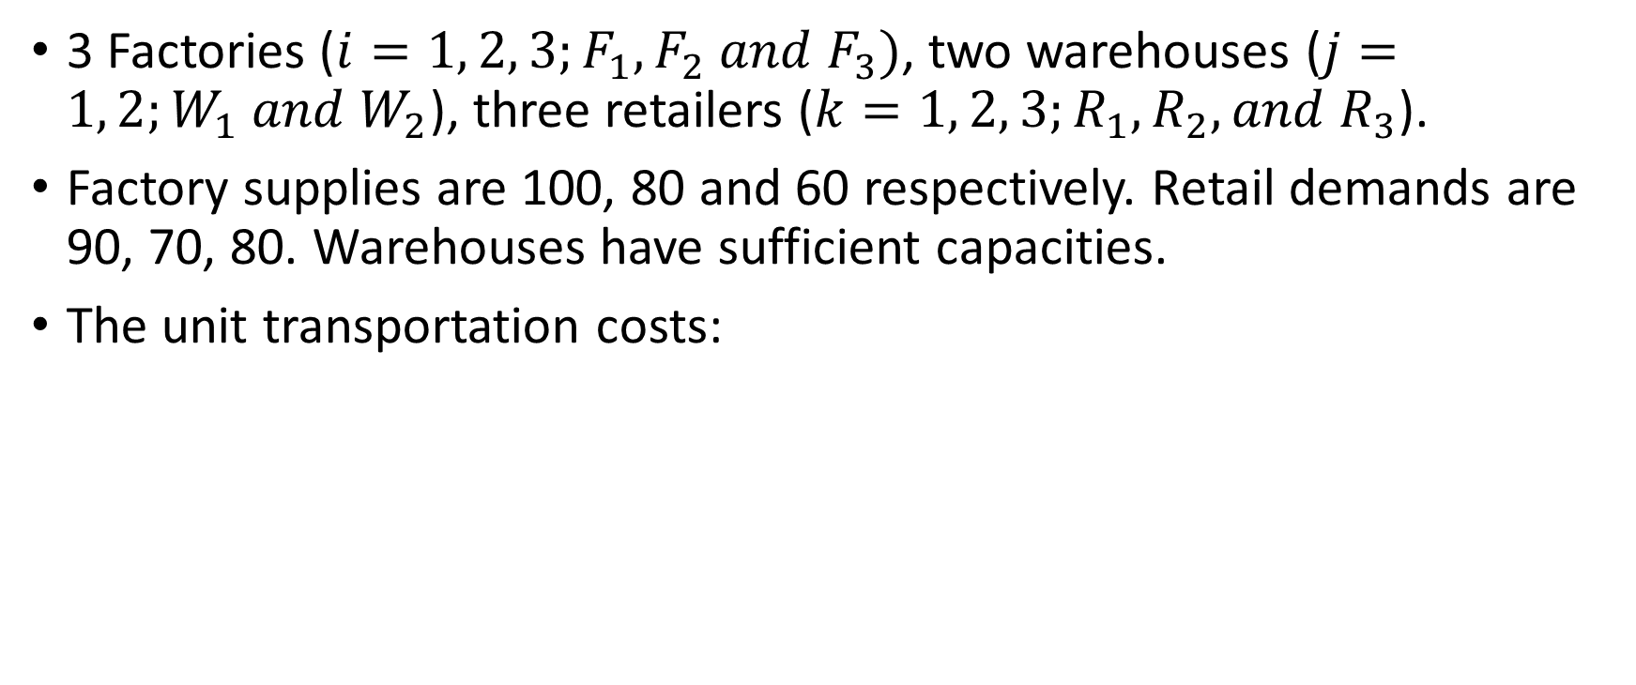
Multistage transportation problem: Numerical example
3 Factories ($i=1, 2, 3;F_{1},F_{2} and F_{3})$, two warehouses ($j=1, 2;W_{1} and W_{2}$), three retailers ($k=1, 2, 3;R_{1}, R_{2}, and R_{3}$).
Factory supplies are 100, 80 and 60 respectively. Retail demands are 90, 70, 80. Warehouses have sufficient capacities.
The unit transportation costs:
Link | $F_{1}$ -$W_{1}$ | $F_{1}$ -$W_{2}$ | $F_{2}$ -$W_{1}$ | $F_{2}$ -$W_{2}$ | $F_{3}$ -$W_{1}$ | $F_{3}$ -$W_{2}$ | $W_{1}$ -$R_{1}$ | $W_{1}$ -$R_{2}$ | $W_{1}$ -$R_{3}$ | $W_{2}$ -$R_{1}$ | $W_{2}$ -$R_{2}$ | $W_{2}$ -$R_{3}$
Cost | 8 | 7 | 9 | 5 | 7 | 4 | 10 | 5 | 9 | 8 | 6 | 3

Slide 6
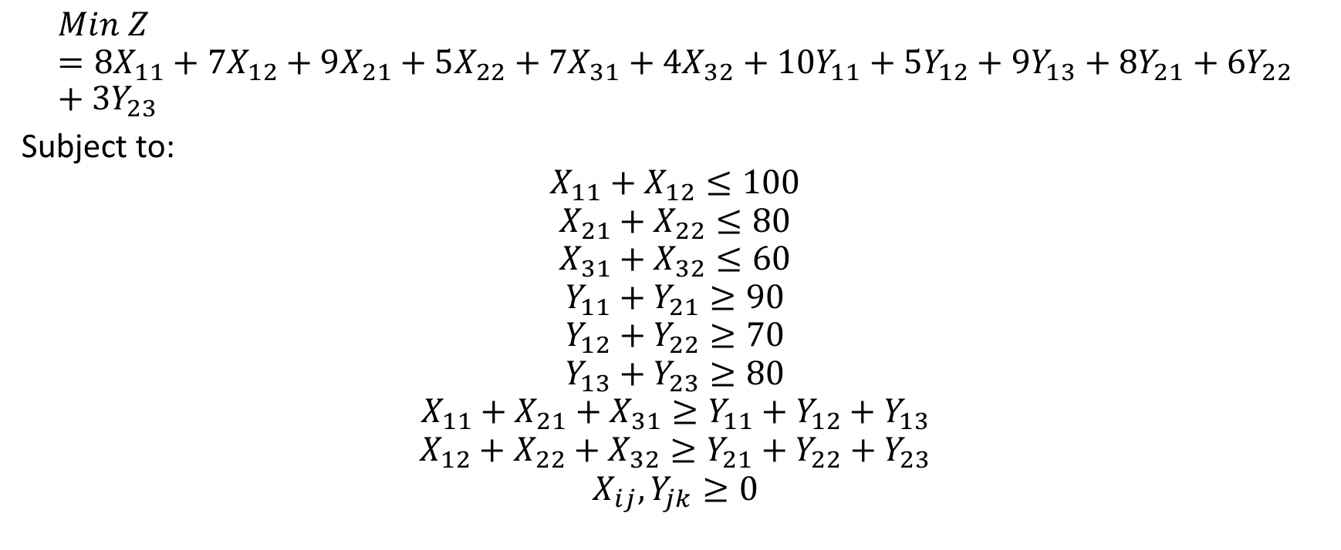
Numerical example
$$Min Z=8X_{11}+7X_{12}+9X_{21}+5X_{22}+7X_{31}+4X_{32}+10Y_{11}+5Y_{12}+9Y_{13}+8Y_{21}+6Y_{22}+3Y_{23}$$
Subject to:
$$X_{11}+X_{12}≤100$$
$$X_{21}+X_{22}≤80$$
$$X_{31}+X_{32}≤60$$
$$Y_{11}+Y_{21}≥90$$
$$Y_{12}+Y_{22}≥70$$
$$Y_{13}+Y_{23}≥80$$
$$X_{11}+X_{21}+X_{31}≥Y_{11}+Y_{12}+Y_{13}$$
$$X_{12}+X_{22}+X_{32}≥Y_{21}+Y_{22}+Y_{23}$$
$$X_{ij}, Y_{jk}≥0$$

Slide 7
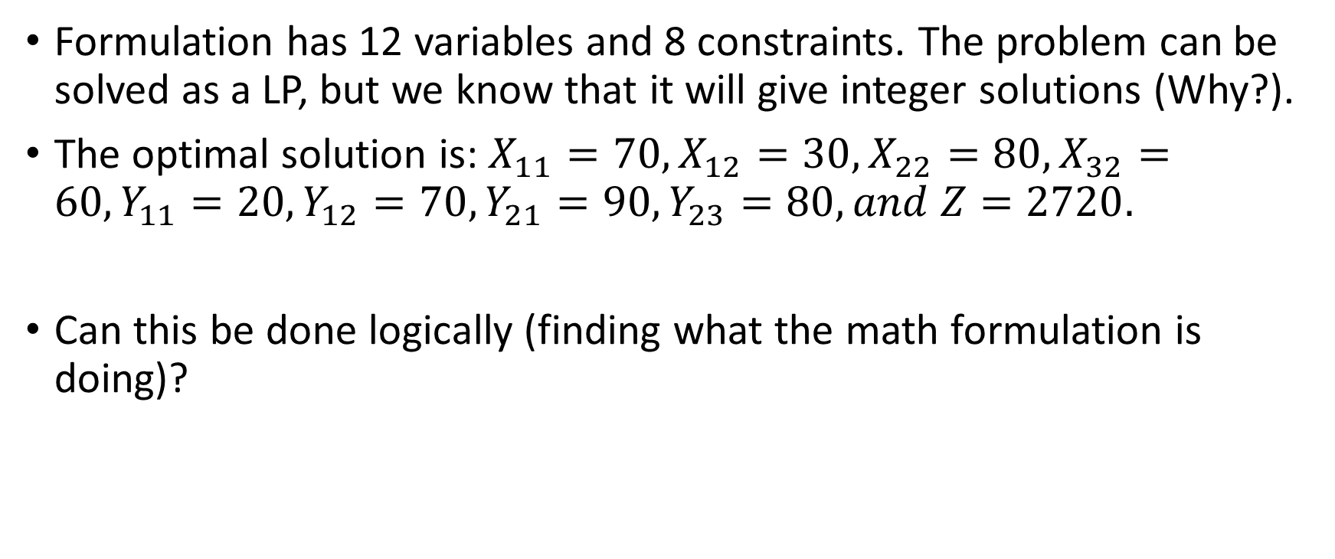
Solution to the numerical example
Formulation has 12 variables and 8 constraints. The problem can be solved as a LP, but we know that it will give integer solutions (Why?).
The optimal solution is: $X_{11}=70, X_{12}=30, X_{22}=80, X_{32}=60, Y_{11}=20, Y_{12}=70, {Y_{21}=90, Y}_{23}=80, and Z=2720.$
Can this be done logically (finding what the math formulation is doing)?

Slide 8
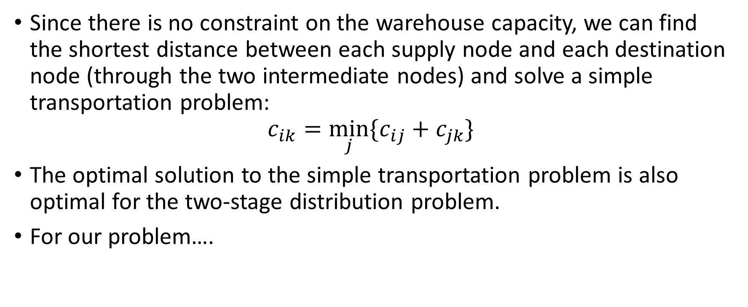
Solution logic
Since there is no constraint on the warehouse capacity, we can find the shortest distance between each supply node and each destination node (through the two intermediate nodes) and solve a simple transportation problem:
$$c_{ik}=\min_{j}{\{c_{ij}+c_{jk}\}}$$
The optimal solution to the simple transportation problem is also optimal for the two-stage distribution problem.
For our problem….

Slide 9
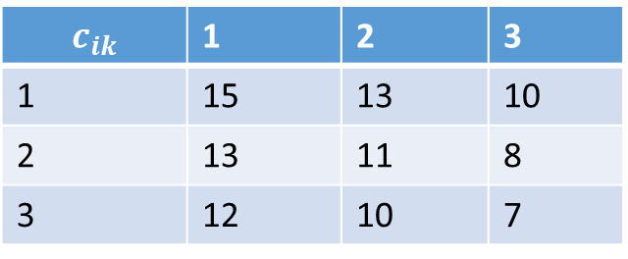

Solution logic
We get the following 3 x 3 matrix:
For example,
$$c_{11}=MIN\left\{C_{F1−W1}+C_{W1−D1},C_{F1−W2}+C_{W2−D1}\right\}$$
$$=MIN\left\{8+10, 7+8\right\}=15$$
$$c_{ik}$$ | 1 | 2 | 3
1 | 15 | 13 | 10
2 | 13 | 11 | 8
3 | 12 | 10 | 7

Slide 10
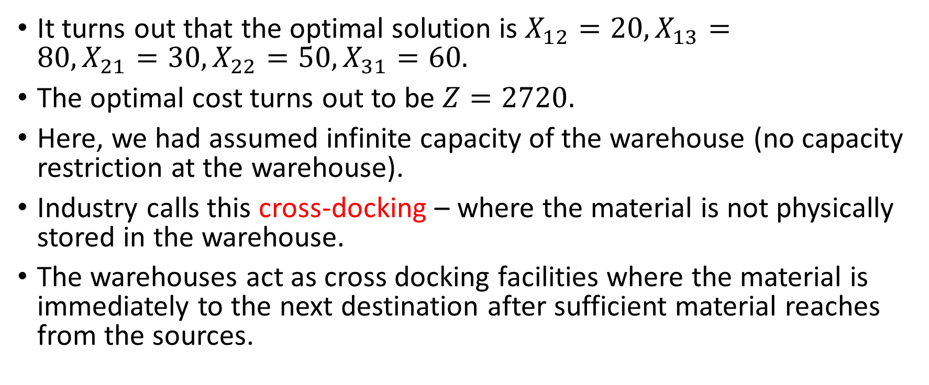
Optimal solution
It turns out that the optimal solution is $X_{12}=20, X_{13}=80, {X_{21}=30, X}_{22}=50, X_{31}=60.$
The optimal cost turns out to be $Z=2720.$
Here, we had assumed infinite capacity of the warehouse (no capacity restriction at the warehouse).
Industry calls this cross-docking – where the material is not physically stored in the warehouse.
The warehouses act as cross docking facilities where the material is immediately to the next destination after sufficient material reaches from the sources.

Slide 11
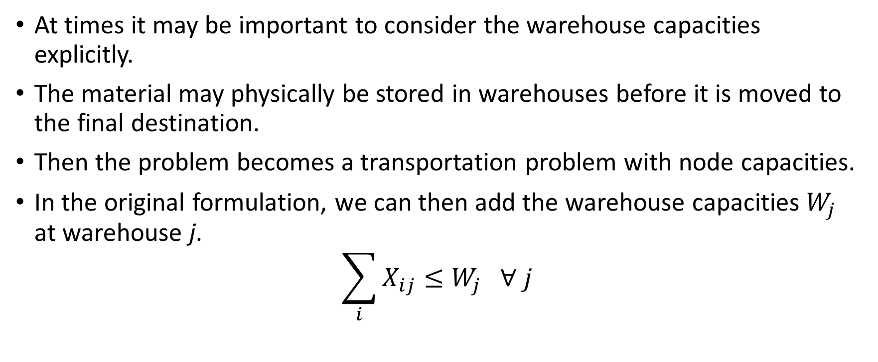
Multistage transportation with node capacities
At times it may be important to consider the warehouse capacities explicitly.
The material may physically be stored in warehouses before it is moved to the final destination.
Then the problem becomes a transportation problem with node capacities.
In the original formulation, we can then add the warehouse capacities $W_{j}$ at warehouse j.
$$\sum_{i}{X_{ij}}≤W_{j} ∀ j$$

Slide 12
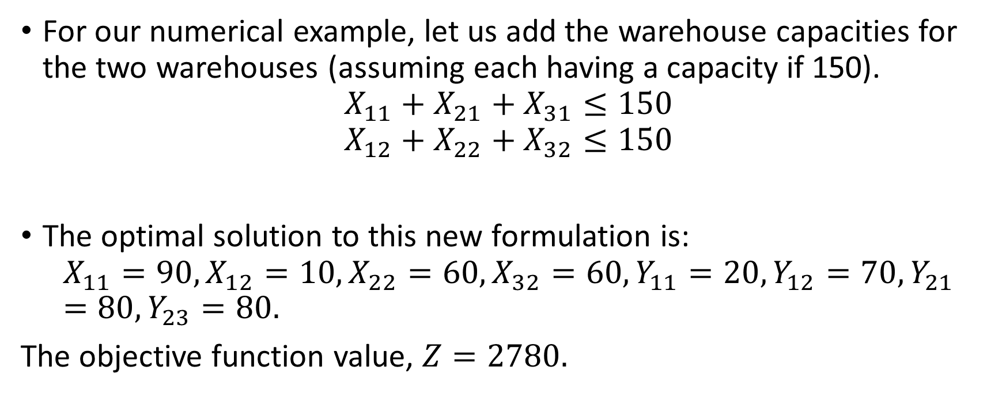
Multistage transportation with node capacities
For our numerical example, let us add the warehouse capacities for the two warehouses (assuming each having a capacity if 150).
$$X_{11}+X_{21}+X_{31}≤150$$
$$X_{12}+X_{22}+X_{32}≤150$$
The optimal solution to this new formulation is:
$$X_{11}=90, X_{12}=10, X_{22}=60, X_{32}=60, Y_{11}=20, Y_{12}=70, Y_{21}=80, Y_{23}=80.$$
The objective function value, $Z=2780.$

